Slide 1

West Virginia
Classroom Benchmark Assessment
Grades 3-8
Test Administrator (Examiner) Training

Slide 2
Test Administrator (Examiner) Criteria
Before Testing
During Testing
After Testing
Segments

Slide 3
CBA Test Administrator (Examiner) Training
Test Administrator (Examiner) Criteria

Slide 4
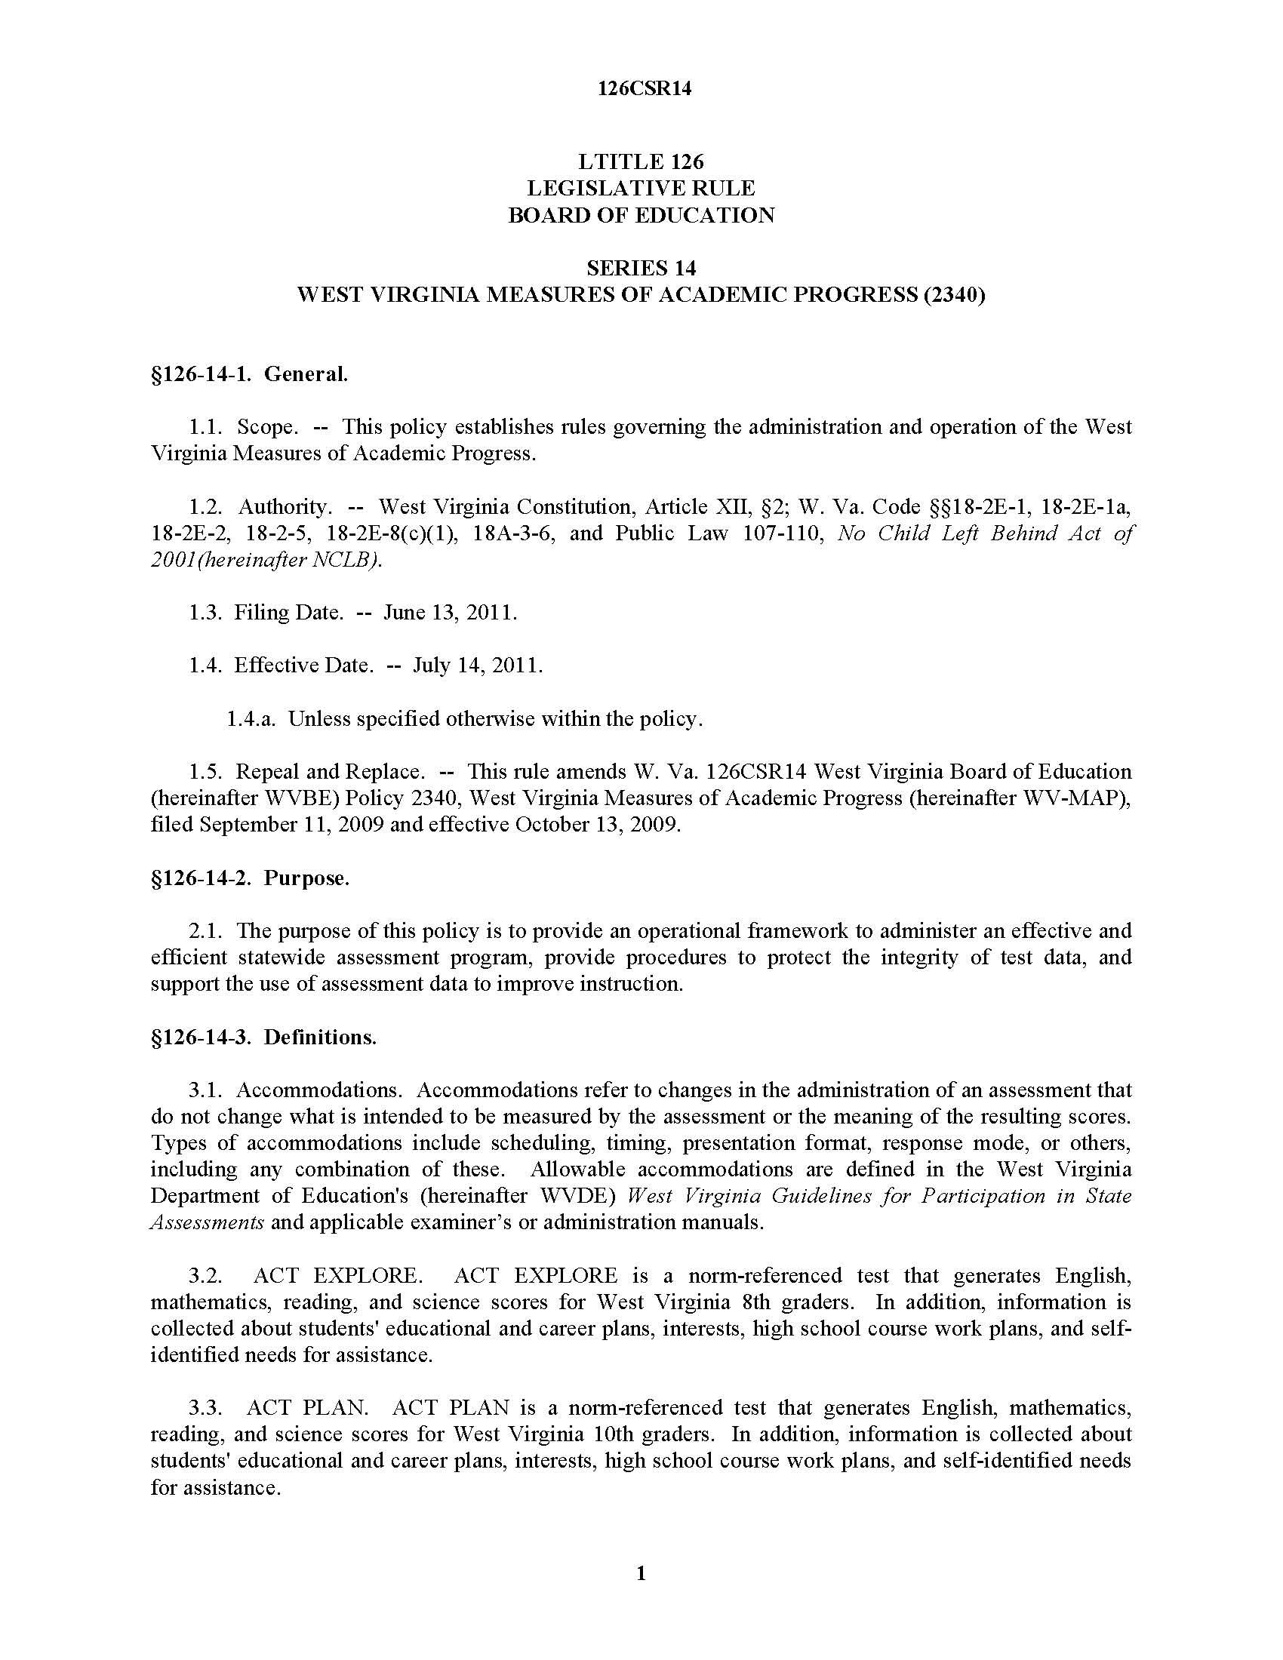
Training is required
annually
for all personnel with access
to secure materials
per WVBE Policy 2340
Annual Training

Slide 5
TITLE 126
LEGISLATIVE RULE
BOARD OF EDUCATION
SERIES 14
WEST VIRGINIA MEASURES OF ACADEMIC PROGRESS (2340)
§126-14-1. General.
1.1. Scope. -- This policy establishes rules governing the administration and operation of the West Virginia Measures of Academic Progress.
1.2. Authority. -- West Virginia Constitution, Article XII, §2; W. Va. Code §§18-2E-1, 18-2E-1a, 18-2E-2, 18-2-5, 18-2E-8(c)(1), 18A-3-6, and Public Law 107-110, Elementary and Secondary Education Act (ESEA).
1.3. Filing Date. -- November 13, 2014.
1.4. Effective Date. -- December 15, 2014.
3.17. Examiner. The person who administers the test.
3.17.a. must be a currently employed educator and/or an approved employee of the state, district or RESA, or a currently employed educator of a nonpublic school; 3.17.a.1 All nonpublic school educators must be approved by the WVDE. 3.17.b. must hold a valid West Virginia teaching license or certification granted by the Office of Professional Preparation; 3.17.c. must have been trained and must have on file a signed Examiner’s/Scribe’s Secure Materials and Test Procedures Agreement for the purpose of administering or assisting with the administration of an assessment included in the WV-MAP and pilot tests and field tests sanctioned by WVDE; 3.17.d. may be a substitute teacher or an aide serving as an examiner for special needs students when instructionally assigned; 3.17.d.1. All aides must be providing services to the student during instruction and must be approved by the WVDE. 3.17.e may not be a student teacher;
Test Administrators
Notes:
Policy 2340 establishes the criteria for examiners.

Slide 6

WVBE Policy 2340
3.17.a. must be a currently employed educator and/or an approved employee of the state, district or RESA, or a currently employed educator of a nonpublic school;
  3.17.a.1 All nonpublic school educators must be approved by the WVDE.
Test Administrators
Notes:
All examiners must be trained and sign the appropriate security agreement. See WV Policy 2340, pages 3-4 for examiner requirements.

Slide 7

WVBE Policy 2340
3.17.b. must hold a valid West Virginia teaching license or certification granted by the Office of Professional Preparation;
Test Administrators

Slide 8

WVBE Policy 2340
3.17.c. must have been trained and must have on file a signed Examiner’s/Scribe’s Secure Materials and Test Procedures Agreement for the purpose of administering or assisting with the administration of an assessment included in the WV-MAP and pilot tests and field tests sanctioned by WVDE;
Test Administrators

Slide 9

WVBE Policy 2340
3.17.d. may be a substitute teacher or an aide serving as an examiner for special needs students when instructionally assigned;
  3.17.d.1. All aides must be providing services to the student during instruction and must be approved by the WVDE.
Test Administrators

Slide 10
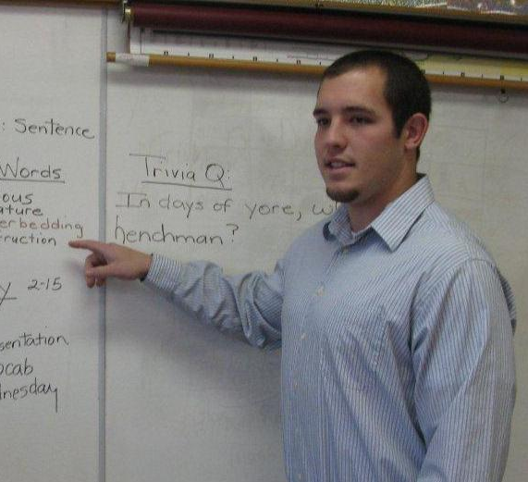
WVBE Policy 2340
3.17.e. may not be a student teacher; unless he or she is a teacher in residence.
  3.17.e.1 Teacher in Residence. An intensively supervised and mentored residency program for prospective teachers during their senior year that refines professional practice skills and helps them gain the teaching experience needed to demonstrate competence as a prerequisite to certification to teach in West Virginia public schools. (W. Va. Code §18A-3-1.)
Test Administrators

Slide 11
WVBE Policy 2340
3.17.f. may not administer WV-MAP assessments to family members.
  3.17.f.1 Decisions regarding other potential conflicts of interests involving test administration will be the responsibility of the district coordinators.
Test Administrators

Slide 12
CBA Test Administrator (Examiner) Training
Before Testing

Slide 13
Training
Test Administrators must be trained on the Testing Code of Ethics and Ethical Testing Practices.
126CSR14
Appendix A
The WVBE Testing Code of Ethics addresses special concerns regarding appropriate professional practices within the West Virginia Measures of Academic Progress (WV-MAP), as well as appropriate professional conduct. The WVBE Testing Code of Ethics supplements the practices and procedures set forth by W. Va.126CSR14, WVBE Policy 2340.
ETHICAL TESTING PRACTICES
Test Security
1. District school personnel shall establish and implement procedures to ensure maximum test security and limit access of secure materials to applicable district/school personnel.
2. Apart from the scheduled test administration to students, secure test materials shall be stored in a locked and secured location by the district test coordinator in accordance with the test administration guidelines of each assessment.
3. The district test coordinator shall be responsible for the test booklets/answer sheets received by the district and shall maintain a record of the booklets sent to each school in accordance to the test administration guidelines of each assessment.
Before Test Administration
Notes:
Examiners must be trained on the Testing Code of Ethics and Ethical Testing Practices.
They must sign the Verification of Training, indicating they have received the proper training.
This form and a copy are kept on file by the principal/building level coordinator and the district test coordinator.

Slide 14
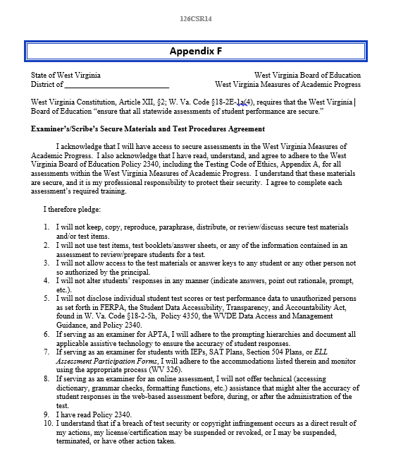
Training
Read Examiner’s / Scribe’s Secure Materials & Test Procedures Agreement – Appendix F
1. I will not keep, copy, reproduce, paraphrase, distribute, or review/discuss secure test materials and/or test items.
2. I will not use test items, test booklets/answer sheets, or any of the information contained in an assessment to review/prepare students for a test.
3. I will not allow access to the test materials or answer keys to any student or any other person not so authorized by the principal.
4. I will not alter students’ responses in any manner (indicate answers, point out rationale, prompt, etc.).
5. I will not share my method of authentication, including, but not limited to, my username and password to access any testing platform or student data/results.
Before Test Administration
Notes:
After the training, examiners must read carefully the directives on the Examiner’s/Scribe’s Secure Materials and Test Procedures Agreement and then sign the form. This agreement remains on file with the principal.

Slide 15
Training
I will not disclose individual student test scores or test performance data to unauthorized persons as set forth in FERPA, the Student Data Accessibility, Transparency, and Accountability Act, found in W. Va. Code §18-2-5h, Policy 4350, the WVDE Data Access and Management Guidance, and Policy 2340.
If serving as an examiner for alternate assessment, I will adhere to the prompting hierarchies and document all applicable assistive technology to ensure the accuracy of student responses.
If serving as an examiner for students with IEPs, SAT Plans, Section 504 Plans, or ELL Assessment Participation Forms, I will adhere to the accommodations listed therein and monitor using the appropriate process (WV 326).
If serving as an examiner for an online assessment, I will not offer technical (accessing dictionary, grammar checks, formatting functions, etc.) assistance that might alter the accuracy of student responses in the web-based assessment before, during, or after the administration of the test.
I have read Policy 2340.
I understand that if a breach of test security or copyright infringement occurs as a direct result of my actions, my license/certification may be suspended or revoked, or I may be suspended, terminated, or have other action taken.
Before Test Administration
Notes:
After the training, examiner’s must read carefully the directives listed on the Examiner’s/Scribe’s Secure Materials and Test Procedures Agreement and then sign the form. This agreement remains on file with the principal.

Slide 16
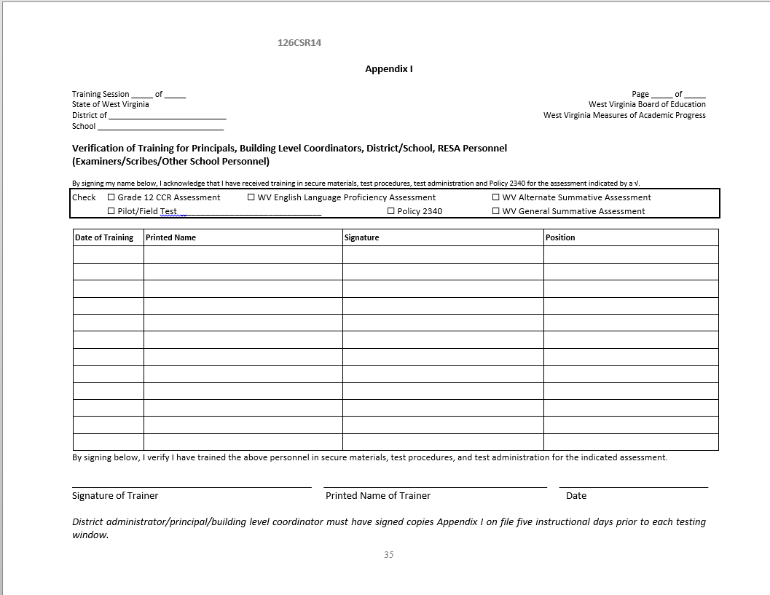
Training
After training, Test Administrators must sign the Verification of Training, Appendix I.
This form and a copy are kept on file by the SC and DC.
Before Test Administration
Notes:
Examiners must be trained on the Testing Code of Ethics and Ethical Testing Practices.
They must sign the Verification of Training, indicating they have received the proper training. This form and a copy is kept on file by the principal/building level coordinator and the district test coordinator.

Slide 17
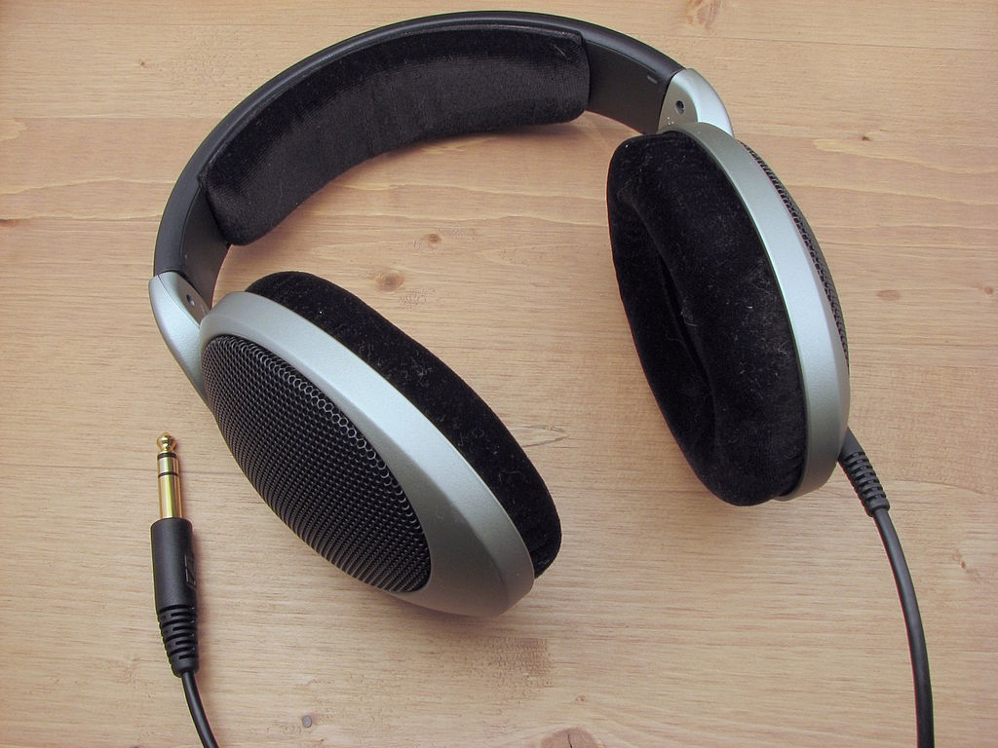
Preparing Materials
Scratch/graph paper should be distributed to students once they are in the testing room, but it is to be shredded when testing is completed.
Headphones must be provided to all students for the ELA listening portion of the assessment and for students who require Text-to-Speech in math and science.
✓
Before Test Administration
Notes:
Science reference sheets will be provided online. Headphones should be provided for all students for the ELA portion of the assessment and for students who require Text-to-Speech in math and science. There will be listening items on the ELA assessment.

Slide 18
CALCULATOR USE
Preparing Materials
Items allowing calculator use have calculators embedded in them.
There is NO calculator use in Grades 3-5.
Appropriate calculators for Grade 6 students will be provided online for student use during the calculator-allowed portion of the mathematics assessment.
Appropriate calculators for Grades 7 and 8 students will be provided online for the entire mathematics assessment.
In Grades 6-8, handheld calculators may be used ONLY by students having the accommodation for special calculators, such braille or talking calculators. The requirement for the special handheld calculator must be documented on their IEPs. The special calculator may on be used only on the calculator-allowed portion of the assessment.
Before Test Administration
Notes:
ONLY students with visual impairments may use a special handheld calculator, such a braille or talking calculator. The requirement for the special handheld calculator must be documented on their IEPs. The special calculator may on be used only on the calculator allowed portion of the assessment.
At Grades 3-5 all items measure basic computational skills, therefore they are not allowable for any students.

Slide 19
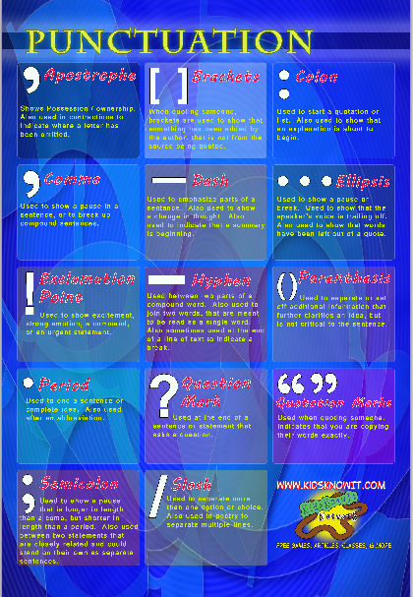



Preparing the Testing Room
Be sure to cover any posted content area materials.
Before Test Administration
Notes:
Remove or cover materials relevant to the test being administered or that might cue answers.

Slide 20

Preparing the Testing Room
Arrange seats to minimize student interaction.
Ensure that desks are clear of all books, papers and other materials.
Provide proper lighting and ventilation.
Before Test Administration
Notes:
Arrange seats in a way that will minimize student interaction.

Slide 21

Preparing the Testing Room
Options to Standardized Setting
Individual (T10), small group (T09), or different class testing may be provided (T11).
Adaptive furniture may be provided (T11).
Special lighting/acoustics (e.g. microphone/speakers) may be provided (T11).
Before Test Administration
Notes:
Refer to West Virginia Guidelines for Participation in State Assessments — 2017-2018 for specific options for students who need adaptive furniture, special lighting or acoustics, or small group/individual test administration.

Slide 22
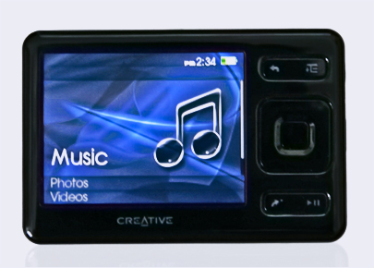
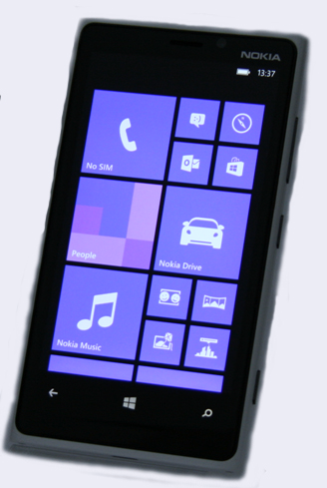


Preparing the Testing Room
Provide an environment free of distractions such as intercoms, cell/smart phones, gaming devices, and watches with alarms and smart watches.
Before Test Administration
Notes:
Provide an environment free of distractions such as intercoms, cell/smart phones, pagers, gaming devices and watches with alarms.

Slide 23
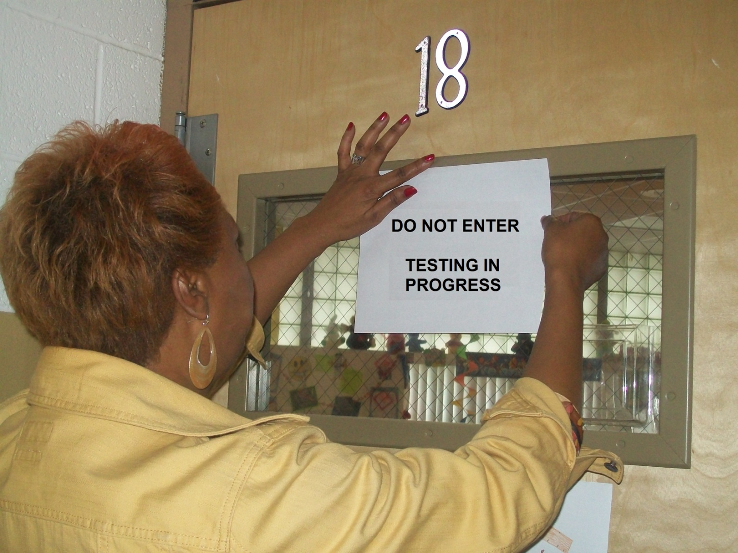
Preparing the Testing Room
✓
To ensure students have a quiet testing environment, free from distraction, place a “Do Not Enter – Testing in Progress” sign on your door.
Before Test Administration
Notes:
Place a “Do Not Enter” sign on your door.

Slide 24
Providing Accommodations
Your principal/school coordinator will provide a list of students needing accommodations.
Accommodations
Notes:
Be sure students are provided the appropriate accommodations. Failure to provide the correct and appropriate accommodations, OR providing more accommodations than a student needs, may lead to invalidation of the student’s scores.

Slide 25

Understand Procedures
If you are not sure of proper procedures, ask your principal/school coordinator!
All questions regarding test administration should be answered before testing begins.
Before Test Administration
Notes:
If you do not understand certain procedures please ask your principal/building level coordinator. it is much better to ask questions before testing begins than to find yourself unprepared once testing starts.

Slide 26
CBA Test Administrator (Examiner) Training
During Testing

Slide 27
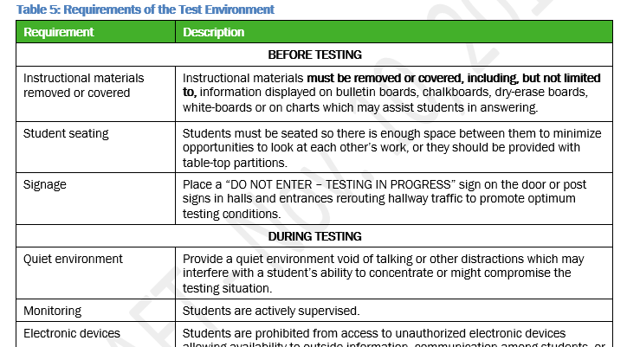
Security of the Test Environment
In addition to WVBE Policy 2340, the Test Administration Manual (TAM) describes security requirements for the test environment during various stages of testing, including what a student can see, hear, or access (including access via technology).
Test Security
Notes:
Appropriate proctoring functions include encouraging students to keep working; ensuring students are answering questions only when/where directed to do so; assisting with computer issues and maintaining a quiet environment.
Please review section 3.0 (Test Security), Section 4.0 (Improprieties, Irregularities and Breaches), and Table 6 in the TAM for details on maintaining test security and reporting test security incidents.

Slide 28
If a test security incident occurs that could affect the integrity of the assessments or the data, contact the principal/school coordinator.
Use the Test Security Incident Log to document the incident.
Test Security
Notes:
Appropriate proctoring functions include encouraging students to keep working; ensuring students are answering questions only when/where directed to do so; assisting with computer issues and maintaining a quiet environment.
Please review section 3.0 (Test Security), Section 4.0 (Improprieties, Irregularities and Breaches), and Table 6 in the TAM for details on maintaining test security and reporting test security incidents.

Slide 29
After a twenty minute pause, students
Will be returned to last page with unanswered questions OR to a new page if all items on previous page were answered; and
MAY NOT review/change any previously answered items, even if they are marked for review.
NOTE:
The 20-minute pause rule only applies to the computer adaptive tests – not the writing test. The writing test must be completed in one session.
Highlighted text and notes on the digital notepad will not be saved when a test is paused.
In the event of a technical issue (e.g., power outage or network failure) or school emergency, longer than 20 minutes, contact school coordinator.
Pauses/Time-outs
Notes:
PAUSE RULES are only for the computer adaptive portion of the tests. The performance tasks may be paused for any length of time.
If a student pauses the test for more than 20 minutes he/she will be locked out of the test. To access the test again the student must log back in using the Test ID provided for him/her at the beginning of the session. The student will automatically be returned to the last page on which there are unanswered questions. If a student had completed a page then he/she will be returned to the first page on which there are “new” questions.
PLEASE NOTE: If a student pauses a test for more than 20 minutes he/she will not be able to review/change any previously answered items OR any items that were marked for review. Also, any highlighted text or notes on the digital notepad will be erased. Therefore, it is recommended that before taking a break or pausing for more than 20 minutes students finish items marked for review as well as any items for which they need highlighting or digital notes.

Slide 30
CBA Test Administrator (Examiner) Training
After Testing

Slide 31
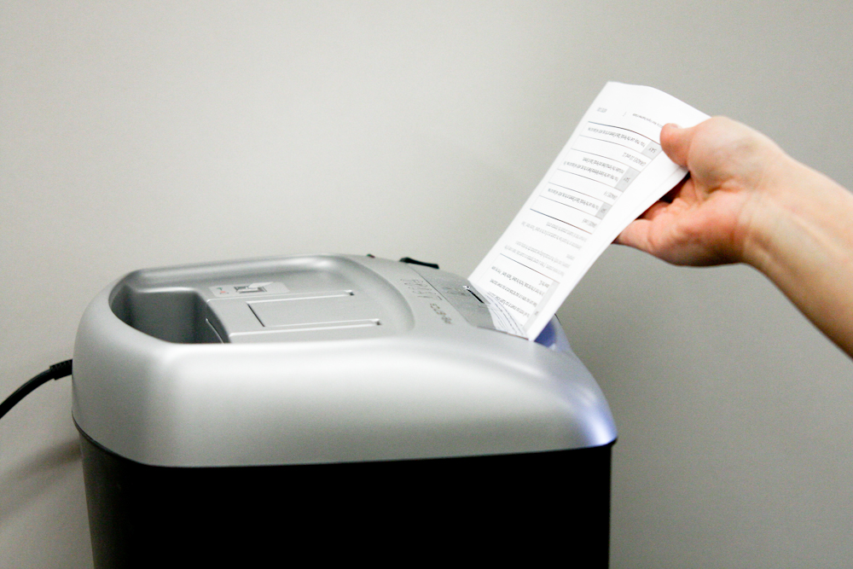
Shred all graph and scratch paper
SHRED

