Slide 1

West Virginia
Classroom Benchmark Assessment
Grades 3-8
School Coordinator Training

Slide 2
Before Testing
During Testing
After Testing
Content Areas
Invalidations/Retests
Large Print and Braille
Segments

Slide 3
CBA School Coordinator Training
Before Testing

Slide 4
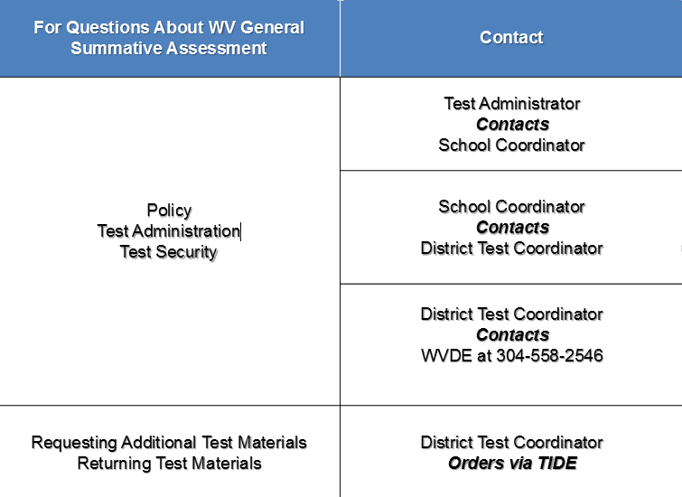
For Questions about Comprehensive Benchmark Assessment
Policy Questions about CBA

Slide 5

Technical Questions

Slide 6
Single Sign-in for All Systems
Systems:
      Test Information Distributive Engine (TIDE)
      Test Delivery System (TDS)
      Online Reporting System (ORS)
      Data Entry Interface (DEI)
      AIRWays
      Interim Teacher Item Previewer
Testing Systems

Slide 7
Environment Clear of Disruptions
Limit:
      Fire Drills
      Bells
      Announcements
      Etc.
Testing Environment

Slide 8
Test materials must be stored in locked and secured location(s) prior to and following each daily testing session. Test materials are to be stored in school in accordance with the administration guidelines of each assessment. Access to secure test booklets and answer sheets, as well as any secure online content, by all persons other than the district test coordinator, principal, and school coordinator shall be restricted to the scheduled dates of test administration as outlined in the WVBE Testing Code of Ethics (Appendix A).
Storing Test Materials

Slide 9
Test Administrator Training
Test administrators must be trained on:
Policy 2340
Test administration procedures
Testing environment
Testing systems
Test Administrator Training

Slide 10
Accommodations
Be sure to confirm each student’s accommodations are correct in TIDE.
Accommodations

Slide 11
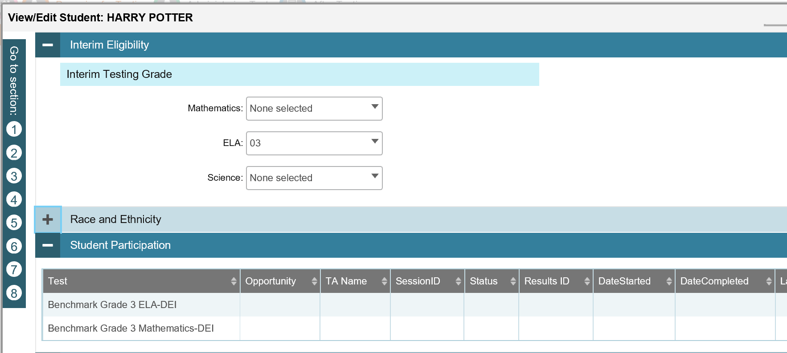
Interim grade levels can be adjusted.
Tests taken during the current year will appear here.
Interim Grade Levels and Student Participation in TIDE
Notes:
Screen Shot

Slide 12
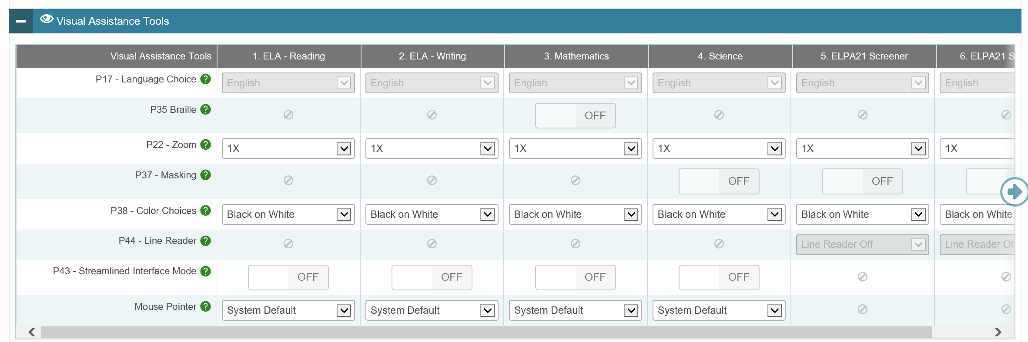
View the visual accommodations embedded in TDS for the student in each content area.
Note: Zoom, Color Choices, and Pointer may be locally set.
Embedded Accommodations in TIDE – Visual
Notes:
Screen shots

Slide 13
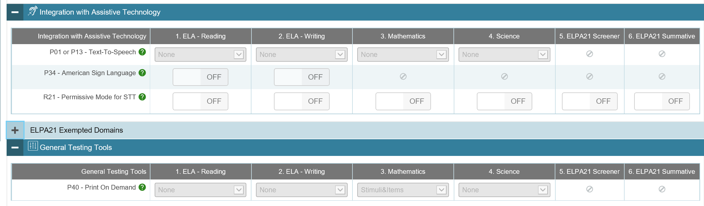
View the integration with assistive technology and general testing tools accommodations embedded in TDS for the student in each content area.
Assistive Technology and General Tools Accommodations in TIDE
Notes:
Screen shots

Slide 14
CBA School Coordinator Training
During Testing

Slide 15
Monitoring
Monitoring during test administration lessens the likelihood of test irregularities.
Be visible in hallways during testing to minimize disruptions
Be available to assist Test Administrators
Monitoring

Slide 16
CBA School Coordinator Training
After Testing

Slide 17
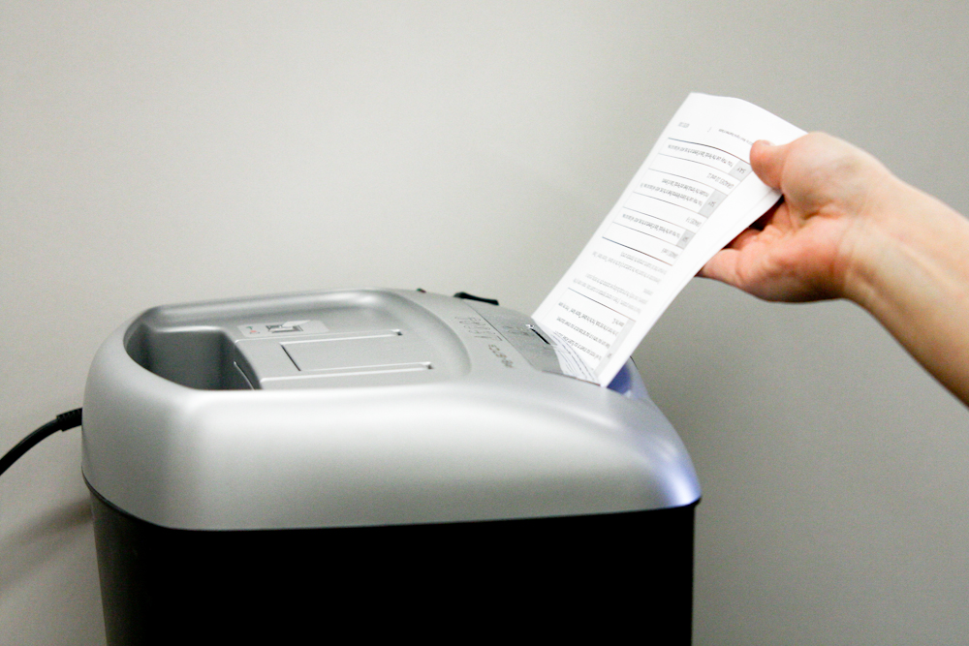
Shred all graph and scratch paper
SHRED

Slide 18
CBA School Coordinator Training
Content Area Tests

Slide 19
Content Area Tests:
  Math
    Grades 3-8
  ELA - Reading
    Grades 3-8
  ELA - Writing
    Grades 3-8
Content Area Tests

Slide 20
Math:
Grades administered
  3-8
Session
  Computer Adaptive Test
Key administration points
  Item Review
    Can only review items in current test segment
  Calculators
    Provided online during calculator segment – Grade 6 only (unless accommodation for special calculator)
    Provided online for entire test – Grades 7 and 8
Math Tests

Slide 21
ELA - Reading:
Grades administered
  3-8
Session
  Computer Adaptive Test
Key administration points
  Item Review
    Can only review items in current segment
ELA - Reading Tests

Slide 22
ELA - Writing:
Grades administered
  3-8
Session
  Online test
  Test must be completed on the same day as started
Key administration points
  Must be completed in one session
ELA - Writing Tests

Slide 23
CBA School Coordinator Training
Appeals

Slide 24
CREATING APPEALS:
  Who can create an appeal?
  Only the DC
  Where is an appeal created?
  Appeals are created in TIDE
  How is TIDE’s appeal system used?
  Create appeal(s)
  Check status of appeal(s)
  View outcomes of appeal(s)
Creating Appeals

Slide 25
Appeals | Definition
Reset | Allows student to start a new test
Invalidation | Not scored; no retest
Restore | Reinstates a reset test
Grace Period Extension | Extends the 20 minute pause rule
Appeals

Slide 26
Students with pending appeals will not be able to access the content area tests until the appeal is resolved.
Pending Appeals

Slide 27
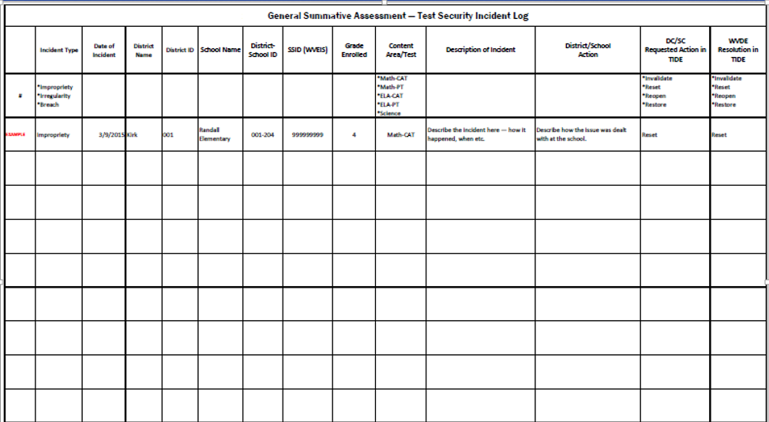
Test Security Incident Log

Slide 28
CBA School Coordinator Training
Large Print and Braille

Slide 29
NO Answer Documents
Answer Documents

Slide 30
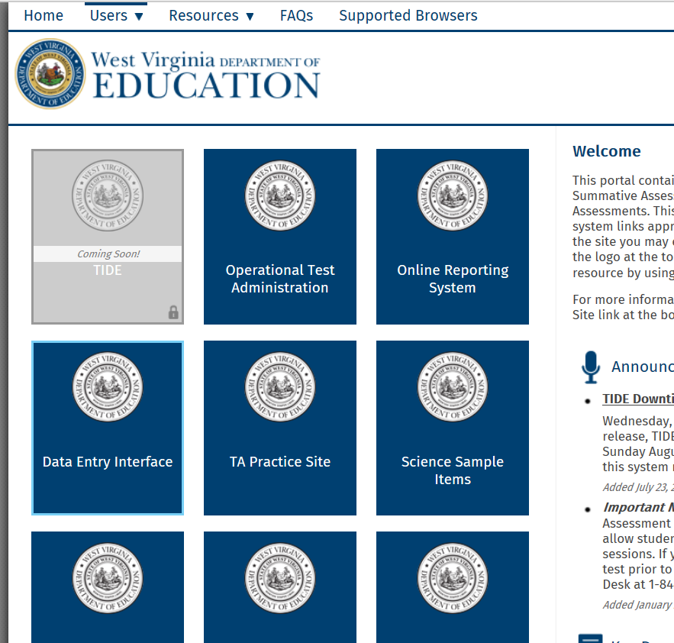
Data Entry Interface
Use the Data Entry Interface (DEI) to enter student responses.
Click on the DEI card on the WVGSA portal.
Sign in to the AIR single sign in system.
Enter student’s first name and ID number (WVEIS) and click Sign in.
The test will load and be just as the student would see if he/she logged into the secure browser.
Enter student responses just as the student wrote them in his/her test book.
Data Entry Interface

Slide 31
Data Entry Interface
Students using paper test books (large print, braille) will not be able to enter their responses using the secure browser.
Students will write their responses in their test books or using the braille writer.
Educators (scribes) will use the DEI to enter student responses prior to the end of the test window.
Educators (scribes) are not to use the secure browser to enter student responses.
Data Entry Interface

Slide 32
Large Print Test book
  Arrive in district August 12th
Braille Test book
  Arrive in district August 12th
Materials

Slide 33
Large Print and braille books
  One shipment to the district office
Security checklist
  Included in the packaging materials
Return shipping information
  Included in the packaging materials
Security checklist
  Used to record the distribution and collection of the braille, Large Print, and regular test books
Receiving Materials

Slide 34
FedEx
  Receipt and return of materials, unless otherwise communicated
Test materials
  Arrive at the district
  Labeled with the DC’s name and shipping address
Box labels
  Reference school name, sequentially numbered
Receiving Materials

Slide 35
  District Box 1 – administrative materials for DC use
    May also contain secure test materials – refer to the packing list
  Using the District Packing List and School Packing List(s)
    Sort boxes by school building
    Verify that you have received all required boxes - if not, call the Help Desk
  Distribute materials to School Coordinators
    Save boxes for returning test materials
  Using the District Security Checklist
    Verify your district overage – serial numbers are recorded on the security checklist
    Do NOT open packages of test books not intended for immediate use
Ensure all test materials are stored in
locked and secure location.
Receiving Materials - DISTRICT

Slide 36
  Box labels
    School name, sequentially numbered
  Box 1 – administrative materials for school coordinator use
    May also contain secure test materials, refer to your School Packing List
  Using the School Security Checklist
    Verify school order – serial numbers are recorded on the security checklist
    Do NOT open packages of test books not intended for immediate use
  Compare types and quantities of materials received with your testing needs
    Report any discrepancies to DC
  Place test materials in secure and locked location
  Save the box(es) for returning materials
Receiving Materials - SCHOOL

Slide 37
Braille Test Kit
Braille test books will be packaged with associated materials in a kit
  Cover sheet
  Plastic-bound braille test book
  Regular test book (for read aloud)
  Instructions for administration
  Packet of ancillary materials (located on the inside back cover of the braille books)
Receiving Materials

Slide 38
Large Print Test Kit
Large Print test books will be packaged with associated materials in a kit
  Cover sheet
  Large print test book
  Regular test book (for read aloud)
  Instructions for administration
Receiving Materials

Slide 39
Grades 5 and 8 students
Three test books
  ELA & Writing
  Math
  Science
Grade 3, 4, 6, and 7 students
Two test books
  ELA & Writing
  Math
Test Books

Slide 40
Types of braille forms
Paper test book availability
  ELA
  Math
  Science
Print on Demand availability
  ELA
  Math
  Not for science
Online Tactile Graphics (P35) availability
  Math
  Not for ELA
  Not for science
Braille

Slide 41
Student Responses
Large Print test book
  Student places all answers in the Large Print test book
  Educator (scribe) will enter all student answers into DEI
  Requires a scribe and the R04 accommodation
Braille test book
  Educator (scribe) will enter all student answers into DEI
  Requires a scribe and the R04 accommodation
Student Responses

Slide 42
Additional Large Print or braille test books will be ordered through TIDE.
Additional Materials

Slide 43
Return the materials
Collect and return all
  Regular test books
  Braille
  Large Print test books
Schools should return all materials as soon as possible after students have completed testing.
Returning Materials

Slide 44
  Return Kit
    Return labels
    FedEx return shipping labels
    School header sheets
    Return shipping instructions
Returning Materials

Slide 45
Separate secure and non-secure materials:
  Secure materials
    Test books
  Non-secure materials
    Unused print-on-demand pre-ID and box labels
    Printed test administration manuals and directions for administration
Returning Materials

Slide 46
Secure Materials
Pack all test books in boxes
  Affix a red non-scorable label to the top of all boxes containing secure materials
  Number each box sequentially
Returning Materials

Slide 47
Non-secure Materials
Do not return to Measurement Inc.
  Shred
    Unused print-on-demand pre-ID and return shipping box labels
  Discard
    Printed test administration manuals
Returning Materials

Slide 48
Instructions for Returning Materials
Remove or black out any old shipping labels
Affix the FedEx ground package return label (from return kit) directly on top of the original address label
  If additional labels are needed contact the AIR Help Desk.
Retain the receipt tab, from the FedEx ground package return label
Contact FedEx to arrange a pickup of your materials
  Use www.fedex.com: select “Ship”, then select “Schedule and Manage Pickups” from the drop down menu, then click “Schedule Ground Return Pickup”.
  Have your receipt tab(s) handy when you make your request
  Call FedEx Customer Service: 1-800-463-3339; explain you need a “Package Returns Program” pickup.
  Provide materials to your regular FedEx Ground driver
Materials must be returned no later than
one week after testing is complete.
Returning Materials

Slide 49
Damaged test books
  Student got sick
  Student bled
  Etc.
Send letter requesting permission from WVDE to destroy test book; include,
  Student information
    Name
    SSID
    Grade level
    School
    County
  Test book information
    Content area
    Grade
    Bar code number
Destroy test book in manner consistent with bio-hazard guidelines
Bio-Hazards

Slide 50


